Slide 1

SPAM E-MAIL DETECTION PROJECT
By – Umesh Mahajan
Batch - 32

Slide 2
SPAM DETECTION PROJECT
The SMS Spam Collection is a set of SMS tagged messages that have been collected for SMS Spam research
Spam Detector is used to detect unwanted, malicious and virus infected texts and helps to separate them from the nonspam texts
This is a UK forum in which cell phone users make public claims about SMS spam messages, most of them without reporting the very spam message received

Slide 3

EDA
In : We have total 5572 rows and 5 columns In : Checking Data Type of All Data In : v2object Unnamed: 2object Unnamed: 3object Unnamed: 4object dtype: object As we can see all are object hence we need to treat them so that ML models can understand In : dtype: int64 We Have null values in some unnecessary column which we are going to drop and there is not missing values present in actual important Data In : 5572 rows × 2 columns In : Out : 2 spam747 Name: target, dtype: int64 We can see that How unique values are distributed in all over dataset so that we can get little idea

Slide 4
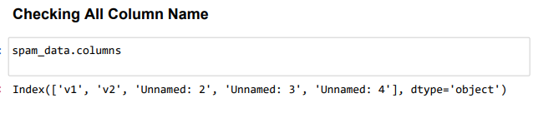
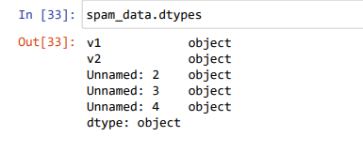
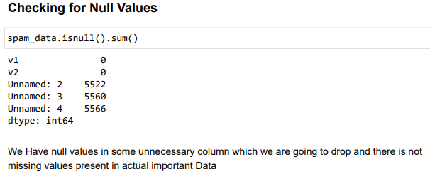
Understanding data

Slide 5


Data Cleaning
We tried to clear our data by removing Unnecessary columns and

Slide 6
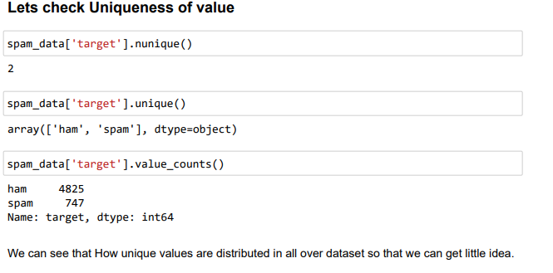
Uniqueness of Data

Slide 7
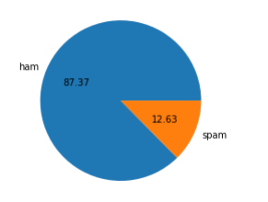
Visualization

Slide 8

Data preprocessing

Slide 9

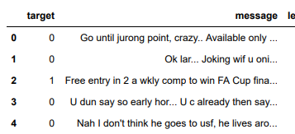
Mapping target with Numbers

Slide 10
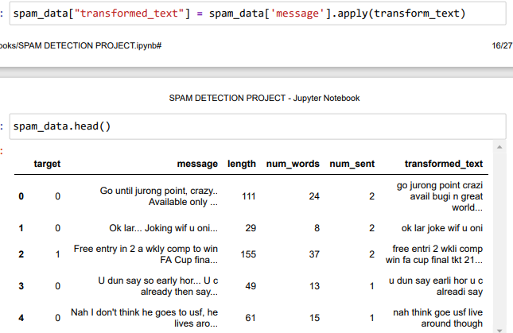
Transforming Data comments

Slide 11
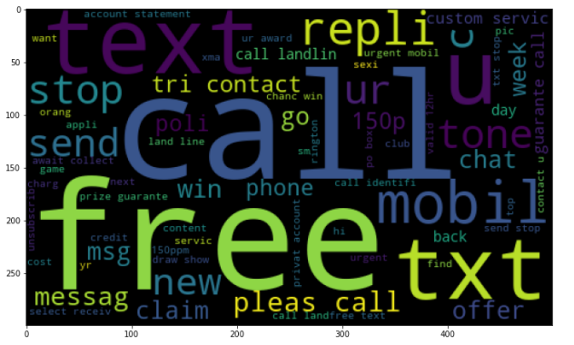
Most used word to make spam

Slide 12
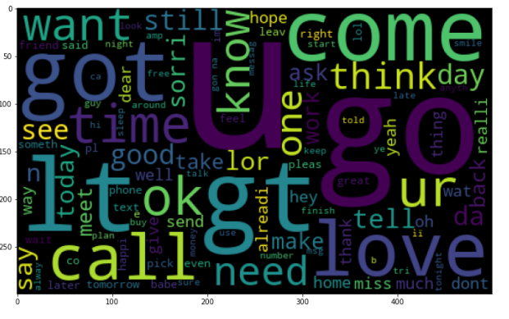
No Spam word

Slide 13

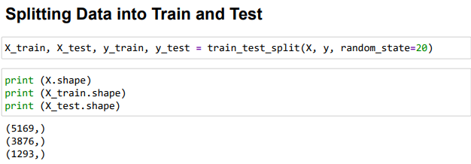
Splitting Data in train and test

Slide 14
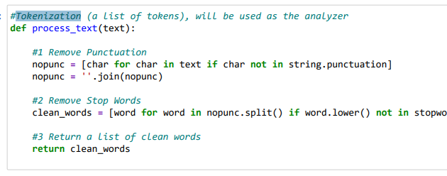
Tokenization

Slide 15
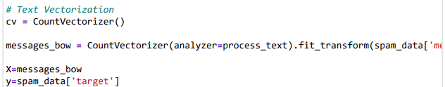
Text Vectorization

Slide 16
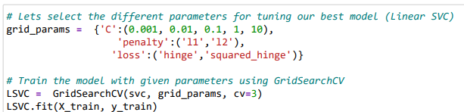
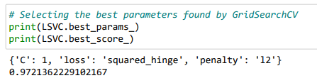

HyperParameter Tuning Linear SVC with GridSearchCV

Slide 17

Saving the Model

Slide 18

Best Model
In : After applying the hyper parameter tuning the best accuracy score obtained was 98.06651198762569% which can be further improved by obtaining more data and working up through other parameter combinations

Slide 19

Thank You

